Slide 1

November 2020
Inside Sherpa – Digital Internship
Technology, Strategy & Architecture – TS&I
Work in Progress Module Tasks and Ideal Responses
Deloitte Virtual Intern

Slide 2
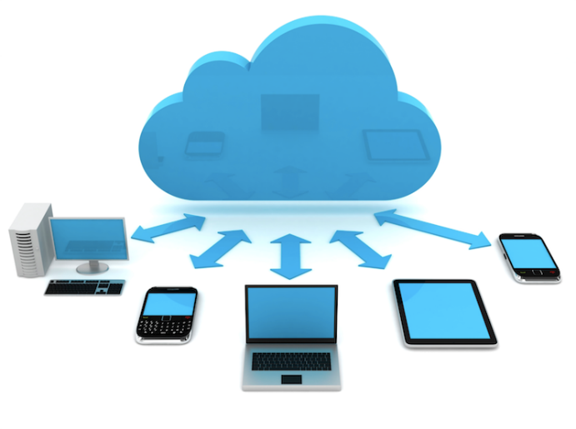
UNDERSTANDING CLOUD COMPUTING
Defining Cloud Computing
What is Cloud computing?
"The cloud" refers to servers that are accessed over the Internet, and the software and databases that run on those servers. Cloud servers are located in data centers all over the globe. By using cloud computing, users and companies do not have to manage physical servers themselves or run software applications on their own machines. In simple terms cloud computing means storing and accessing data and programs over the Internet instead of your computer's hard drive.
Many large scale companies use cloud technologies like Salesforce, AWS, Microsoft Azure. Netflix for example uses AWS to control the flow of content for its multitude of subscribers. Outsourcing this data storage and processes would benefit Netflix immensely because they only pay for what they use and due not need to incur the liability costs of the equipment, hardware, employees and facilities.

Slide 3
UNDERSTANDING CLOUD COMPUTING
Cloud Characteristics
On-demand self-services: The Cloud computing services does not require any human administrators, user themselves are able to provision, monitor and manage computing resources as needed.
Broad network access: The Computing services are generally provided over standard networks and heterogeneous devices.
Rapid elasticity: The Computing services should have IT resources that are able to scale out and in quickly and on as needed basis. Whenever the user require services it is provided to him and it is scale out as soon as its requirement gets over. Cloud computing provides interoperability.
Resource pooling: The IT resource (e.g., networks, servers, storage, applications, and services) present are shared across multiple applications and occupant in an uncommitted manner. Multiple clients are provided service from a same physical resource.
Measured service: The resource utilization is tracked for each application and occupant, it will provide both the user and the resource provider with an account of what has been used. This is done for various reasons like monitoring billing and effective use of resource.

Slide 4
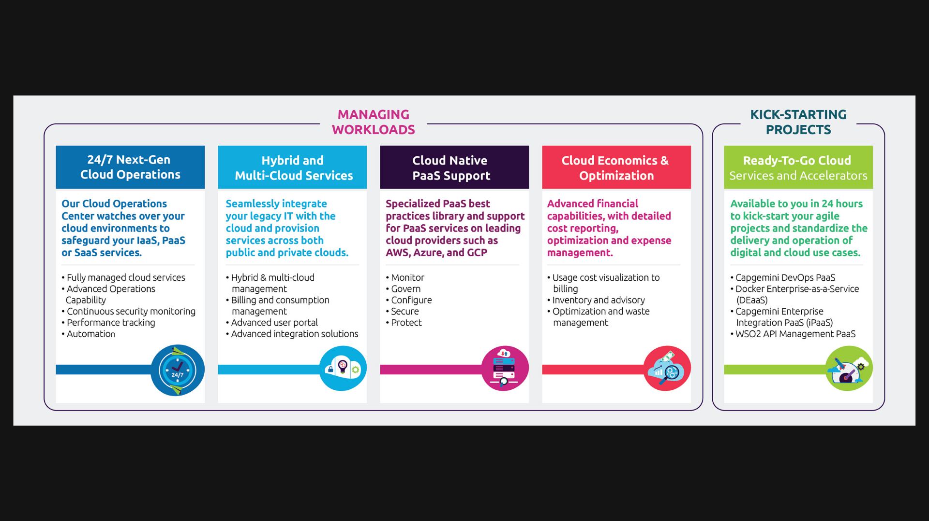
CLOUD COMPUTING APPROACHES

